Slide 1
Module 1: DIY Meals and Snacks
LESSON 4 SIGNATURE DISH
Notes:
Copyright © 2021 Dairy Farmers of Canada
Slide Intent: Introduce the lesson.
Teacher: Read the slide.
This slide deck contains embedded videos. To play videos directly from the slides, click “enable editing” and then click “enable content” on the top bar. Alternatively, you can use the Vimeo links in the notes section of the relevant slides to access the videos.

Slide 2
CHALLENGE
How can you use Canada’s Food Guide to plan and prepare enjoyable meals and snacks?
Notes:
Slide Intent: Review the CTF challenge for the DIY Meals and Snacks module.
Teacher: Read the slide.
Visit https://food-guide.canada.ca/en/ for more information on Canada’s Food Guide.

Slide 3
Notes:
Slide Intent: Highlight the application of Canada’s Food Guide.
Teacher: Here is another example of how to use Canada’s Food Guide to create a meal.
Note: The final foods shown are milk in a reusable bottle, an apple, and a chicken wrap.
If embedded video does not play, use the following Vimeo link to access the video: https://vimeo.com/465807646/a659f94069

Slide 4
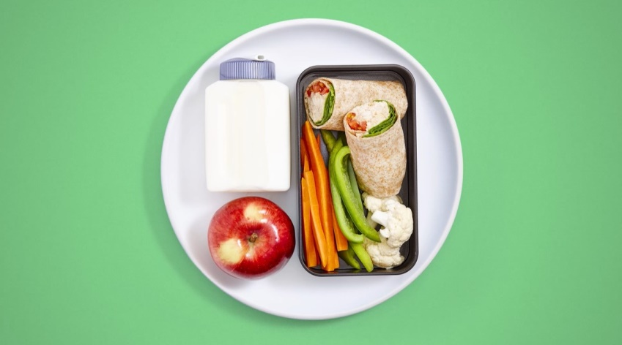
CANADA’S FOOD GUIDE IN ACTION
Notes:
Slide Intent: Highlight the application of Canada’s Food Guide. If you do not have an internet connection, show these image stills instead of the video.
Teacher: Here is another example of how to use Canada’s Food Guide to create a meal.
Note: The final foods shown are milk in a reusable bottle, an apple, and a chicken wrap.

Slide 5
REVIEW
In this module we have looked at the following:
1. Canada’s Food Guide and how to incorporate Health Canada’s recommendations when building meals and snacks. As a starting point,
At meals, choose at least one food from each category (vegetables and fruits, whole grain foods, and protein foods).
At snacks, choose foods from at least two of the three categories (vegetables and fruits, whole grain foods, and protein foods).
Notes:
Slide Intent: Review Lessons 1–3.
Teacher: Read the slide.

Slide 6
REVIEW
2. Exploring variety in food choices to get all of the nutrients you need
3. Factors that affect food choices
Food choices can be based on taste, hunger, food traditions, and health.
The ability to meet these needs is tied to access and resources such as money, time, space, skills, equipment, and support.
Notes:
Slide Intent: Review Lessons 1–3.
Teacher: Read the slide.

Slide 7
ACTIVITY: MY SIGNATURE DISH
PART 1: PLANNING THE MEAL OR SNACK
Remembering what you’ve learned so far, and using the Canada’s Food Guide transformation videos as inspiration, create a signature dish.
1. Choose a meal or snack.
Create your own recipe, or
Use an existing recipe for inspiration, and note changes you made to it.
Notes:
Slide Intent: Introduce the final cooking activity.
Teacher: Review the instructions. Remind students:
If you’re creating a meal, include at least one vegetable or fruit, one whole grain food, and one protein food.
If you’re creating a snack, choose foods from at least two of the three categories (vegetables and fruits, whole grain foods, and protein foods).
Option: Refer to Canadian Goodness (https://dairyfarmersofcanada.ca/en/canadian-goodness) or AlbertaMilk.com for recipes.

Slide 8
2. Decide whether you will record your meal or snack preparation to create a fast-motion step-by-step video, or whether you will photograph each step of the preparation process to show how the recipe is made.
3. Complete the Signature Dish Planning worksheet and have your teacher sign it before you proceed to Part 2.
Notes:
Slide Intent: Introduce the final cooking activity.
Teacher: Read the slide.

Slide 9
PART 2: COOKING AND PRESENTATION
1. Once you have assembled the ingredients for your signature dish, begin preparing your meal or snack while working on your presentation (for example, by filming a video or taking photographs).
2. Complete the Student Reflection: Lesson 4 worksheet.
3. Submit your final presentation video or photographs with your completed Student Reflection: Lesson 4 worksheet.
Notes:
Slide Intent: Introduce the final cooking activity.
Teacher: Read the slide. Activity sheets are included in the Student Workbook.

Slide 10
Notes:
Slide Intent: Inspiration
Teacher: Optional video to show students as an example (crustless quiche)
If embedded video does not play, use the following Vimeo link to access the video: https://vimeo.com/514039786/3d5ec3efed

